Slide 1



UPI
Unified Payment Interface

Slide 2
What is UPI ?
The Unified Payments Interface (UPI) is a revolutionary, user-friendly, real time payment solution that facilitates inter-bank transactions, and enables greater digital payments adoption in the country.
Developed and launched by the National Payments Corporation of India in 2016, UPI is now one of the most preferred payment solutions in India, with over a billion transactions every month.
Payments can be made using a UPI ID, UPI Number, Account number, and an Indian Financial System Code (IFSC).

Slide 3



Benefits
Direct Transfer
No confusion,
Displays name while transferring for surety

Slide 4
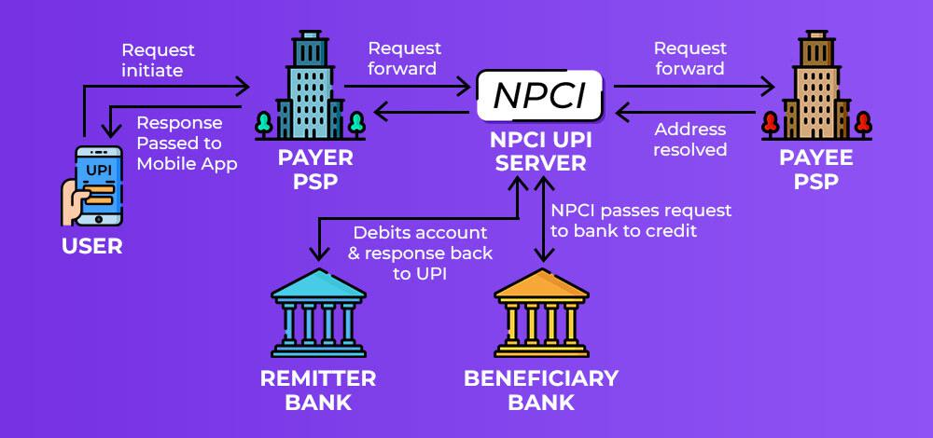
UPI working flow
PSP -
Payment service provider

Slide 5
Transactions done through UPI from Aug-2016 to June-2023

Slide 6
UPI Remitter Banks - Top 10 Banks Performance (Jul'23)
Sr. No. | UPI Remitter Banks (Jul-2023) | Total Volume (In Mn) | Approved % | BD % Business Decline | TD% Technical Decline | Total Debit Reversal Count (In Mn) | Debit Reversal Success %
1 | State Bank Of India | 2574.67 | 95.55% | 4.27% | 0.17% | 8.675316 | 99.41%
2 | HDFC BANK LTD | 879.56 | 96.30% | 3.59% | 0.11% | 2.233976 | 100.00%
3 | Bank of Baroda | 645.14 | 94.64% | 5.21% | 0.15% | 2.143761 | 99.73%
4 | Union Bank of India | 616.05 | 95.63% | 4.35% | 0.01% | 1.726157 | 100.00%
5 | Punjab National Bank | 480.73 | 95.29% | 4.47% | 0.24% | 1.605735 | 100.00%
6 | ICICI Bank | 481.53 | 96.70% | 3.2% | 0.03% | 1.303102 | 92.77%
7 | Axis Bank Ltd. | 462.20 | 96.34% | 3.65% | 0.01% | 1.059541 | 100.00%
8 | Kotak Mahindra Bank | 460.81 | 94.83% | 5.13% | 0.04% | 1.303627 | 100.00%
9 | Canara Bank | 454.62 | 94.32% | 4.97% | 0.71% | 2.063598 | 99.39%
10 | Paytm Payments Bank | 433.01 | 96.43% | 3.55% | 0.02% | 0.623114 | 100.00%

Slide 7
UPI Beneficiary Banks - Top 10 Banks Performance (Jul'23)
Sr.No. | UPI Beneficiary Banks (Jul-2023) | Total Volume (In Mn) | Approved % | BD% Business Decline | TD% Technical Decline | Deemed Approved %
1 | Paytm Payments Bank | 2331.83 | 99.82% | 0.17% | 0.01% | 0.00%
2 | Yes Bank Ltd | 1865.76 | 99.87% | 0.02% | 0.11% | 0.03%
3 | State Bank Of India | 1070.51 | 99.24% | 0.18% | 0.58% | 0.06%
4 | Axis Bank Ltd. | 688.05 | 99.89% | 0.09% | 0.02% | 0.04%
5 | ICICI Bank | 627.95 | 99.79% | 0.10% | 0.12% | 0.05%
6 | HDFC BANK LTD | 510.54 | 99.27% | 0.65% | 0.08% | 0.03%
7 | Bank of Baroda | 290.12 | 99.58% | 0.25% | 0.17% | 0.14%
8 | Union Bank of India | 279.02 | 99.76% | 0.15% | 0.08% | 0.03%
9 | Federal Bank | 229.06 | 99.66% | 0.23% | 0.11% | 0.01%
10 | Canara Bank | 223.29 | 98.89% | 0.43% | 0.68% | 0.23%

Slide 8
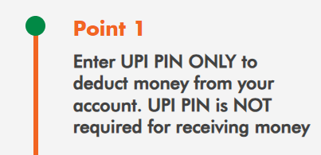
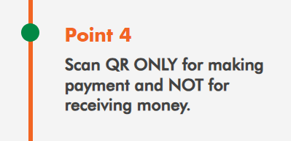
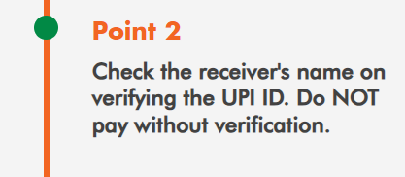
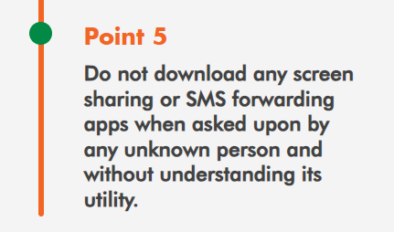
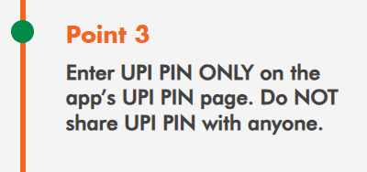
Safety Tips

